Slide 1
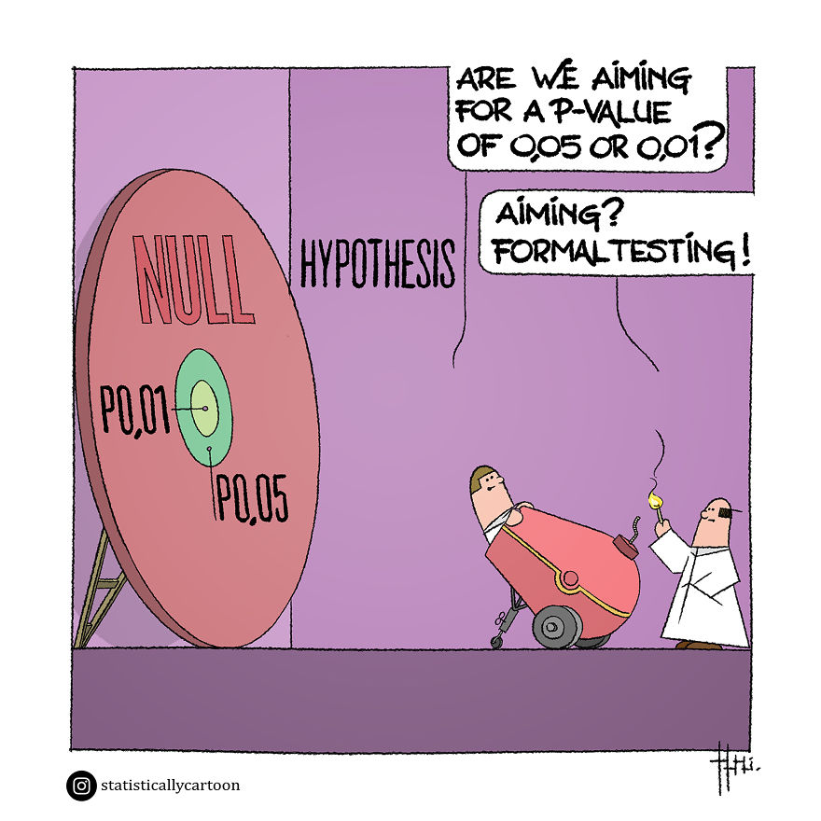
Introduction
PSY 541: Advanced Psychological Statistics and Methods II
01/21/2024

Slide 2
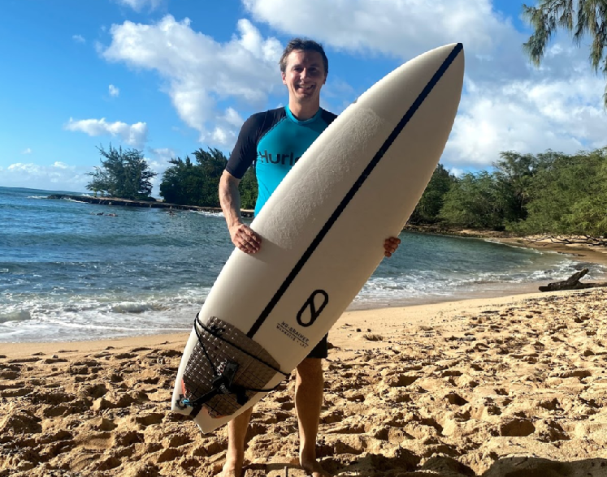
Thank you!
These slides are a fork under license CC-BY-4.0 (Creative Commons Attribution 4.0 International) of Tobi Gerstenberg’s open source slides at github.com/psych252/psych252slides for psych 252 “Statistical Methods for Behavioral and Social Sciences”, which he teaches at Stanford
Until I get all the editing straight, there will be slides that say “I” when they really mean “Tobi Gerstenberg”.

Slide 3

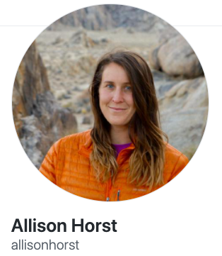
Welcome!
Much Artwork by @allison_horst under CC-BY-4.0. See also allisonhorst.com

Slide 4
Outline
Introduction
What will we learn?
How will we learn?
Tools we will use in class
Some general thoughts
Feedback

Slide 5
Introduction

Slide 6
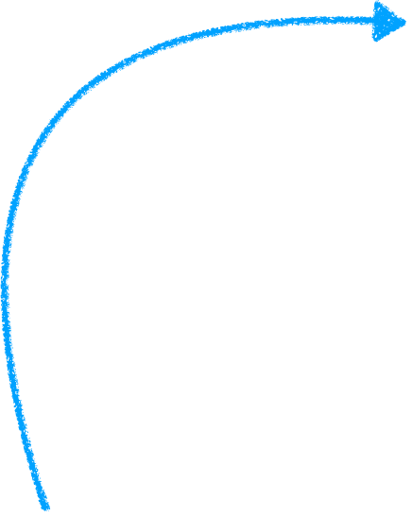
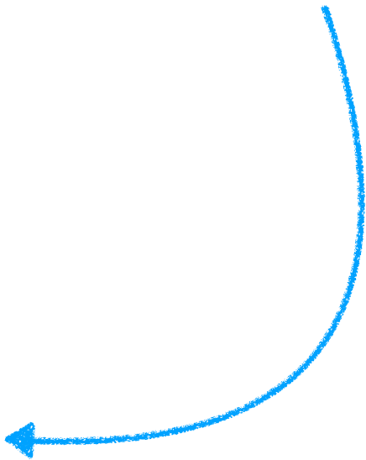
Introduction to the class
master the tools that empower you to do your research
And
develop statistical literacy
Notes:
statistical literacy: formulate your research questions as statistical models; critically evaluate empirical research
tools: great feeling to be able to do it all; lme4 is like giving a chainsaw to a child

Slide 7
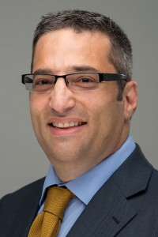
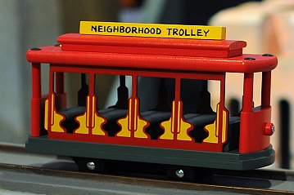
Who Am I?
Alan Cobo-Lewis
Associate Professor of Psychology and Director of the Center for Community Inclusion and Disability Studies
Current Research Interests
Disability
Early childhood care and education
Public policy
Previous Research Interests
Sensation and Perception
Language development in bilingual children
Something fun about me: “I grew up in Mr Roger’s Neighborhood”

Slide 8
Who Are You?
What’s your name?
What are your research interests?
Whose lab are you in?
What do you hope to get out of this class?
What’s something fun about you?
Notes:
https://docs.google.com/presentation/d/1XjZKgUxfg7pxJCfSBvONhtj8qy3k6oRla_q-HO6rOx8/edit?pli=1#slide=id.gaa6d883852_0_20

Slide 9
What will we learn?

Slide 11
Learning goals
You will learn how to use R to ...
- read, wrangle, simulate and analyze data
- make publication-ready plots
Understand the philosophy behind null hypothesis significance testing (NHST) and maybe Bayesian statistics through ...
- running computer simulations and visualizing the results
Formulate research questions as statistical models and ...
- determine which models work best for different situations
Communicate what you have learned about your data ...
- in short presentations in class, showcasing your visualization and analysis
- in written reports
Contribute to open and reproducible science through ...
- adopting good coding practices
- sharing your data and research reports online

Slide 12
What will we learn?
Use R!
Data visualization
Data manipulation/wrangling
Understand key statistical concepts
Simulation, manipulation, visualization
Build models
Formulate hypotheses as statistical models
Report results
Reproducible research

Slide 13
1. Use R!

Slide 14

4 Reasons for why ?
1. Visualization
2. Data manipulation
3. Statistical modeling
4. Communicating results

Slide 15
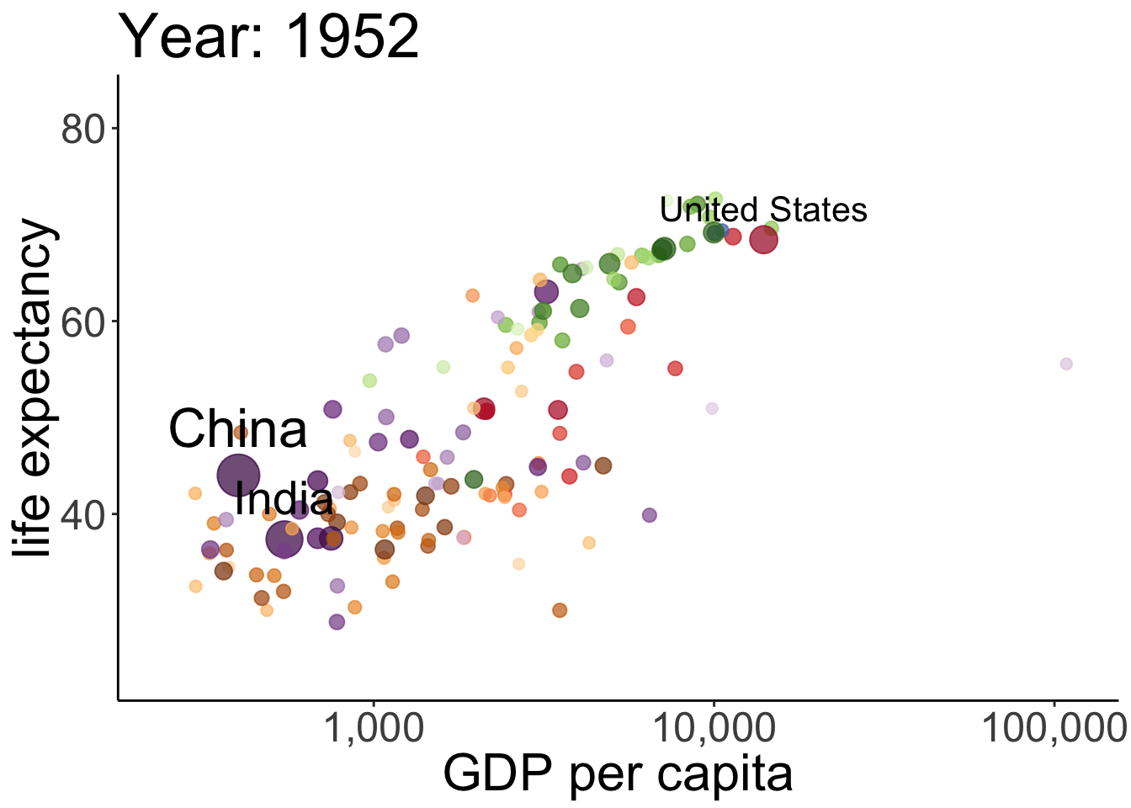
Why ? 1. Visualization
Notes:
Real GDP per capita is a measurement of the total economic output of a country divided by the number of people and adjusted for inflation

Slide 16
Why ? 1. Visualization
1 ggplot(gapminder, mapping = aes(x = gdpPercap, y = lifeExp, size = pop, color = country)) +
2 geom_point(alpha = 0.7, show.legend = FALSE) +
3 geom_text(data = gapminder %>% filter(country %in% c("United States", "China", "India")),
4 mapping = aes(label = country),
5 color = "black",
6 vjust = -0.75,
7 show.legend = FALSE) +
8 scale_colour_manual(values = country_colors) +
9 scale_size(range = c(2, 12)) +
10 scale_x_log10() +
11 labs(title = "Year: {frame_time}", x = "GDP per capita", y = "life expectancy") +
12 transition_time(year) +
13 ease_aes("linear")

Slide 17
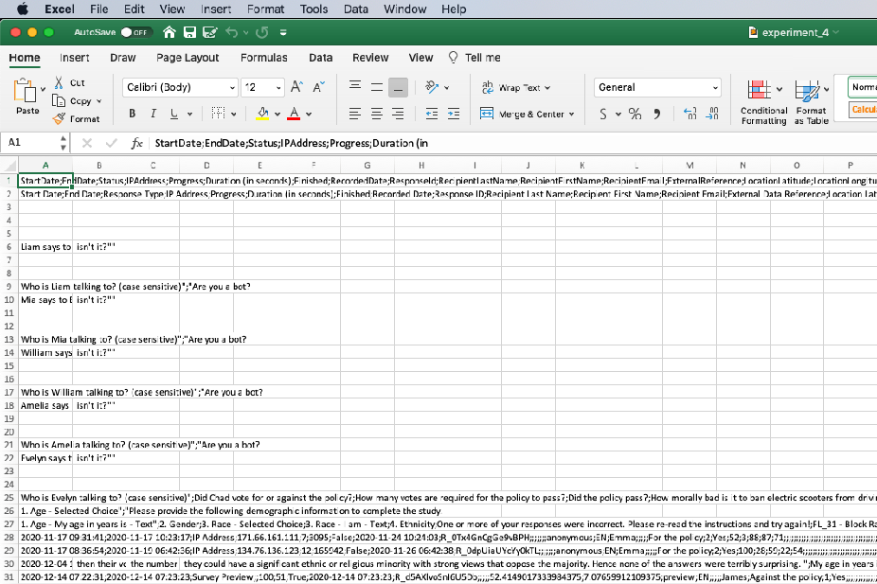


Why ? 2. Data manipulation
thanks qualtrics :(
Making Data Wrangling Less Awful

Slide 18
Why ? 3. Statistical modeling
CRAN = The comprehensive R network
This is what R was developed to do.
(and it continues to develop!!)

Slide 19
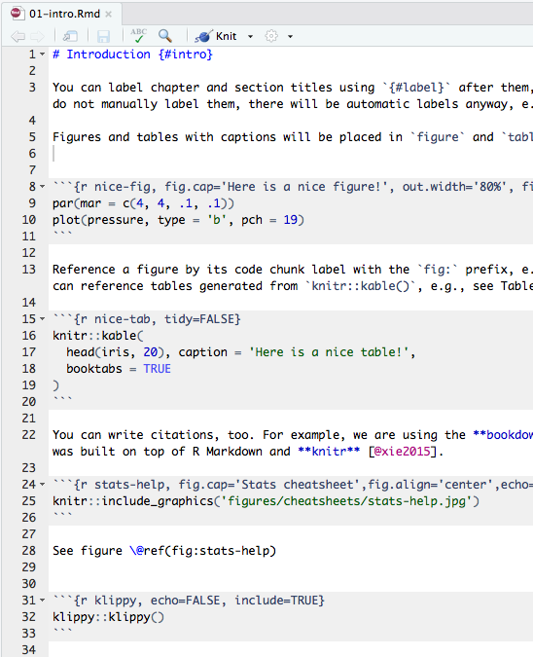
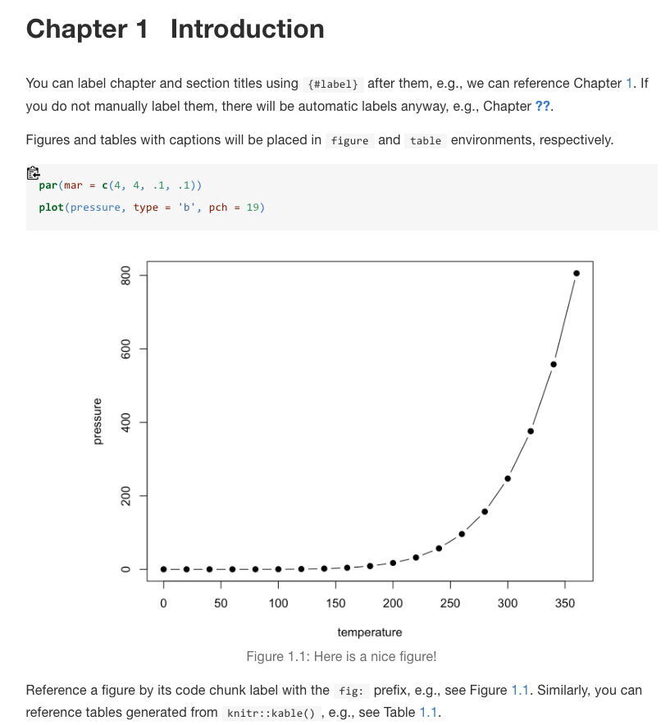
Why ? 4. Communicating results
R Markdown

Slide 20
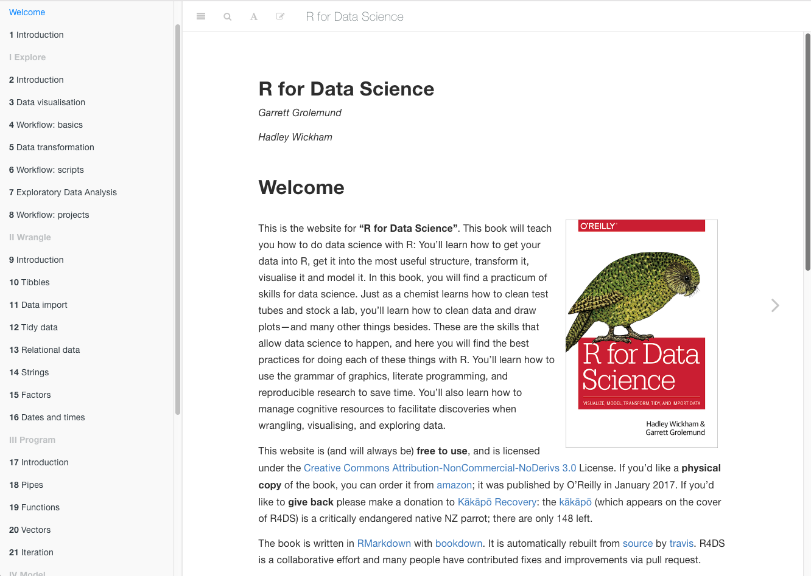
Why ? 4. Communicating results
https://r4ds.had.co.nz/

Slide 21
Why ? Tidyverse
Import: get data into R
Tidy: clean and format the data
Transform: select variables, create new ones, group and summarize
Visualize: "look" at the data in different ways
Model: answer questions about the data
Communicate: write reproducible research reports
Grolemund & Wickham (2016). R for data science: import, tidy, transform, visualize, and model data
Notes:
two modes of knowledge generation:
1) visualization
helps understand what's going on
can surprise you
doesn't scale you
2) modeling

Slide 22
Why ? Also ...
many of people in the world use it
This includes many psychologists
R has a nice online community. #rstats
RStudio is a great IDE (Integrated Development Environment)!

Slide 23
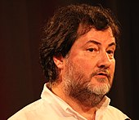

Why is it called R?
At Bell Labs, the statistical programming environment S was developed around 1975-76.
S stood for statistics
Starting in 1988, S-PLUS developed as a commercial implementation of S
In the 1990s, Ross Ihaka and Robert Gentleman started R for their intro stat class at University of Auckland
Licensed under Creative Commons Attribution-Share Alike 2.0 Generic license
Licensed under Creative Commons Attribution 3.0 Unported license

Slide 24
2. Build models

Slide 25
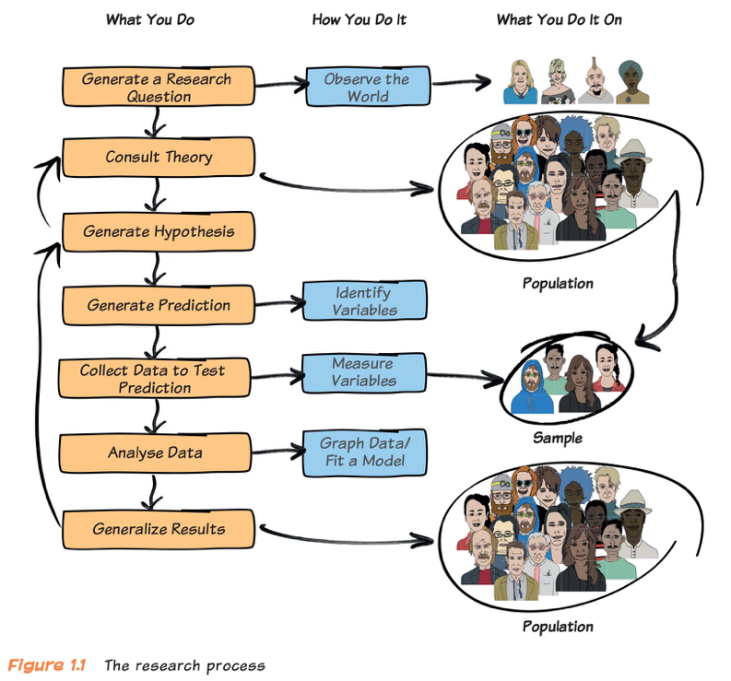
The research process
Notes:
field figure: the research process

Slide 26

Statistics as argument
Researchers use empirical observations (data) for making arguments about research questions.
Statistics is part of a narrative and requires figures, context, rhetoric, prose, ...
Abelson, R. P. (1995). Statistics as principled argument. New York: Psychology Press.

Slide 27
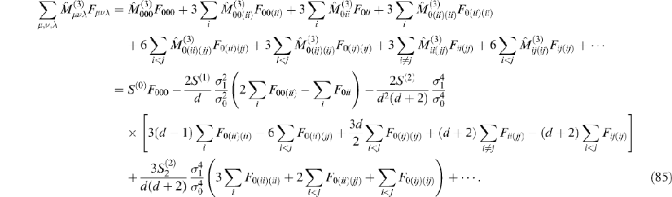
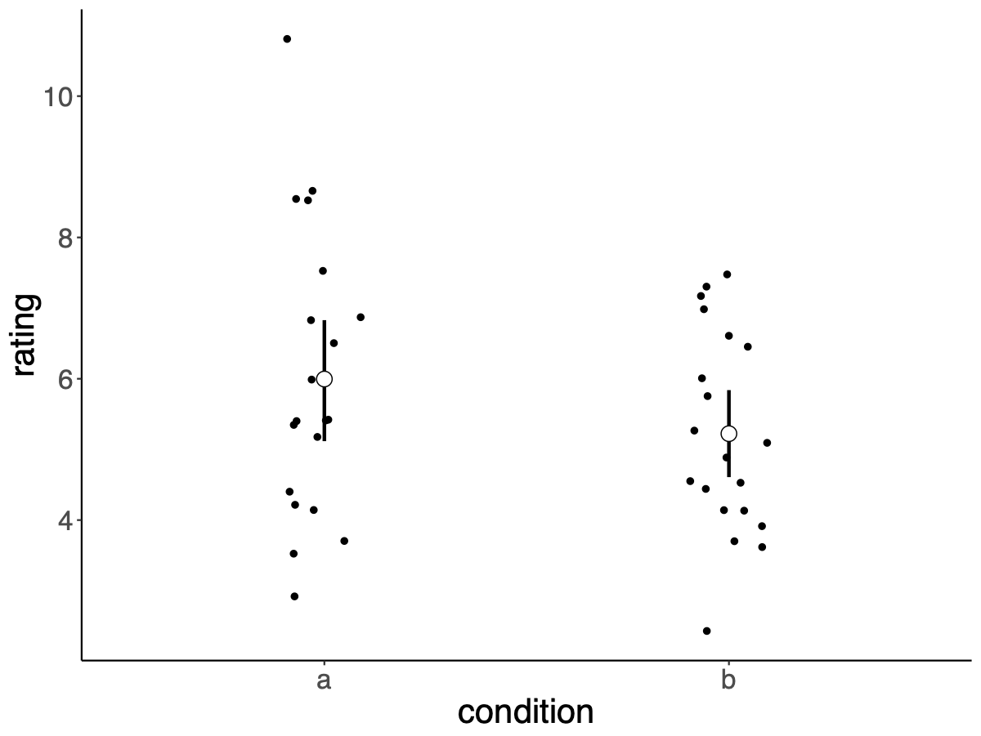
helps us with building models
we'll do
instead of
1 set.seed(0)
2 df.data = tibble(
3 a = rnorm(20, mean = 6, sd = 2),
4 b = rnorm(20, mean = 5, sd = 2)
5 ) %>%
6 gather("condition", "rating")
7
8 df.data %>%
9 group_by(condition) %>%
10 summarize(rating.mean = mean(rating),
11 rating.sd = sd(rating)) %>%
12 kable()
13
14 # calculate the difference between conditions
15 difference.actual = df.data %>%
16 group_by(condition) %>%
17 summarize(rating.mean = mean(rating)) %>%
18 pull(rating.mean) %>%
19 diff() %>%
20 -.
(google search "complicated statistical equation")

Slide 28
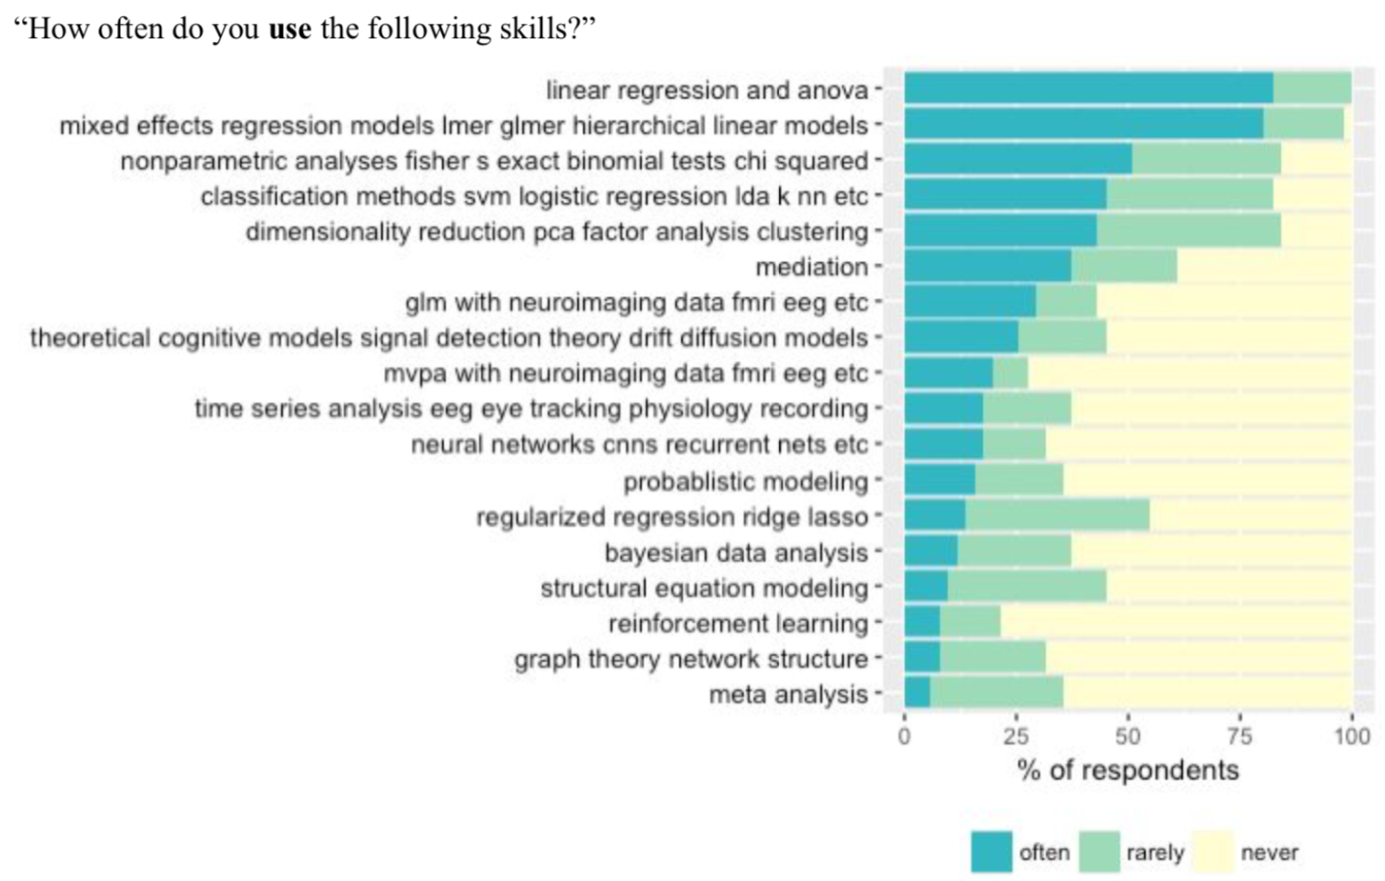

Psychology grad student survey (this is from Stanford)

Slide 29
3. Report results

Slide 30
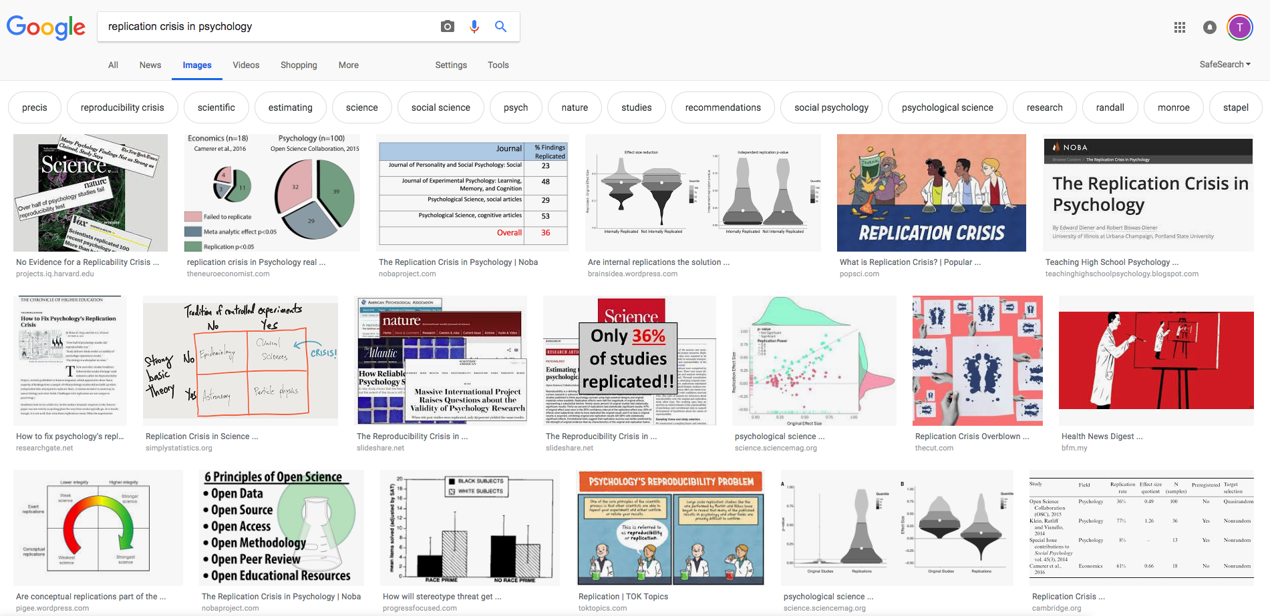
Replication crisis

Slide 31
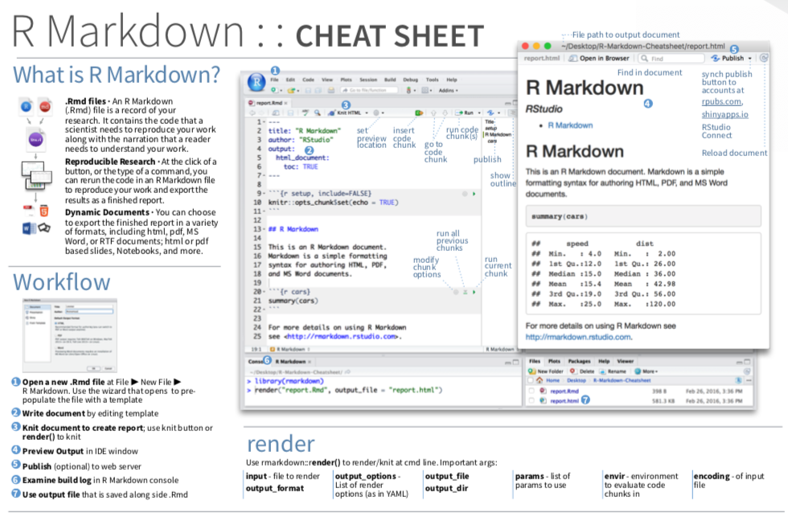

R Markdown
https://bookdown.org/yihui/rmarkdown/

Slide 32

R Markdown
if we use a word document ... :
figures change
results change
copy and paste is error prone
in R Markdown ... :
figures and statistics are updated
no need for copy and paste
everything in one place
even better with version control (e.g. via github)

Slide 33
True Confession
I use Word way more than I use R markdown
That doesn’t mean this is best practice
But I do use R (and R Studio) a LOT

Slide 34


stretch break!
Notes:
play track on spotify

Slide 35
Some Logical or Statistical Fallacies
Base rate fallacy
Correlation and causation

Slide 36
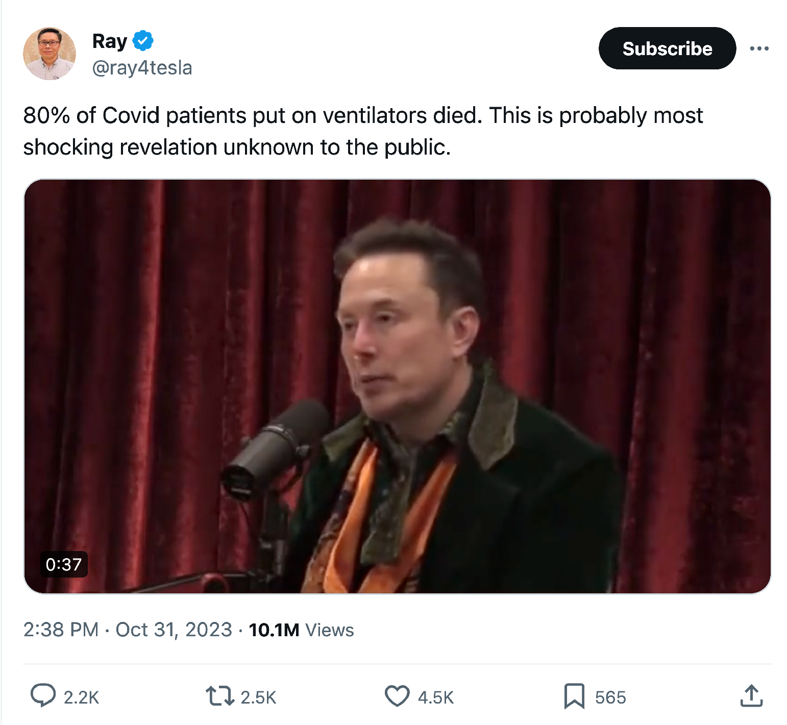
Notes:
@ray4tesla is a tesla fanboy

Slide 37
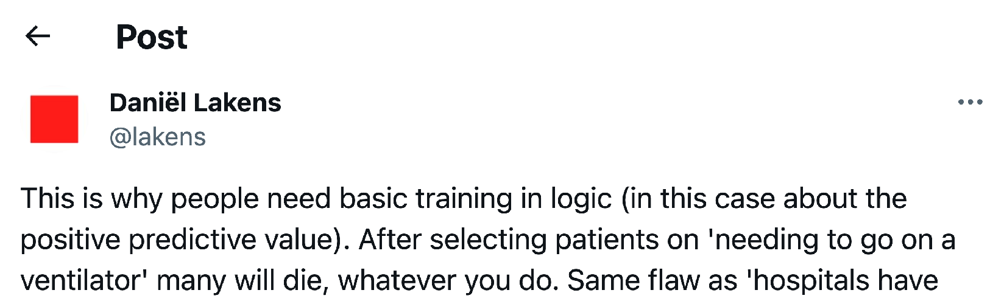

Slide 38
More vaccinated people are hospitalized with COVID than unvaccinated people!

Slide 39
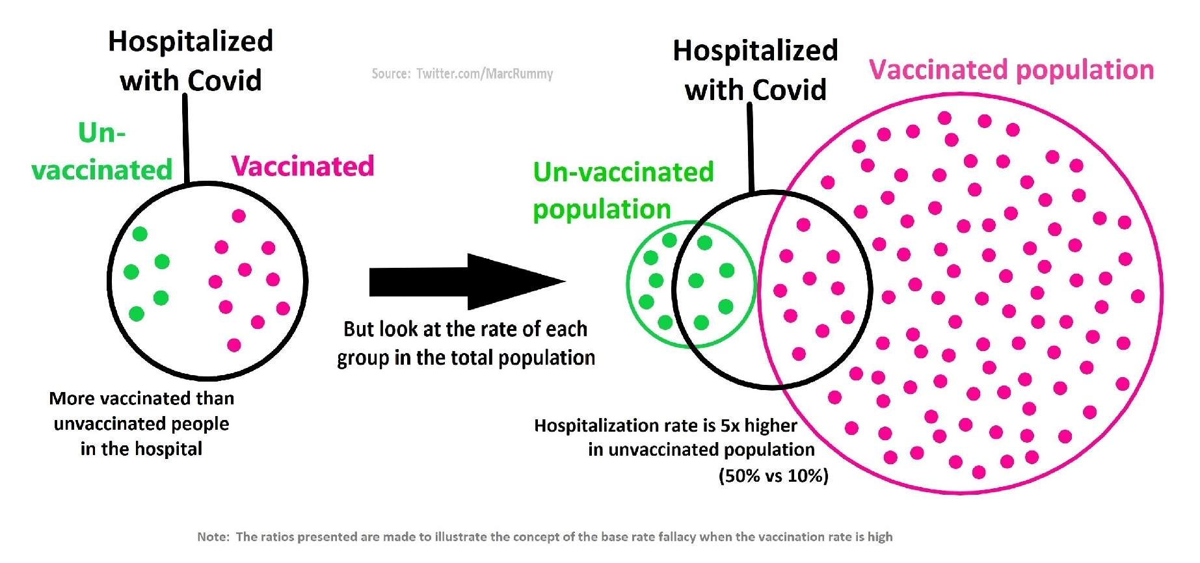

Slide 40
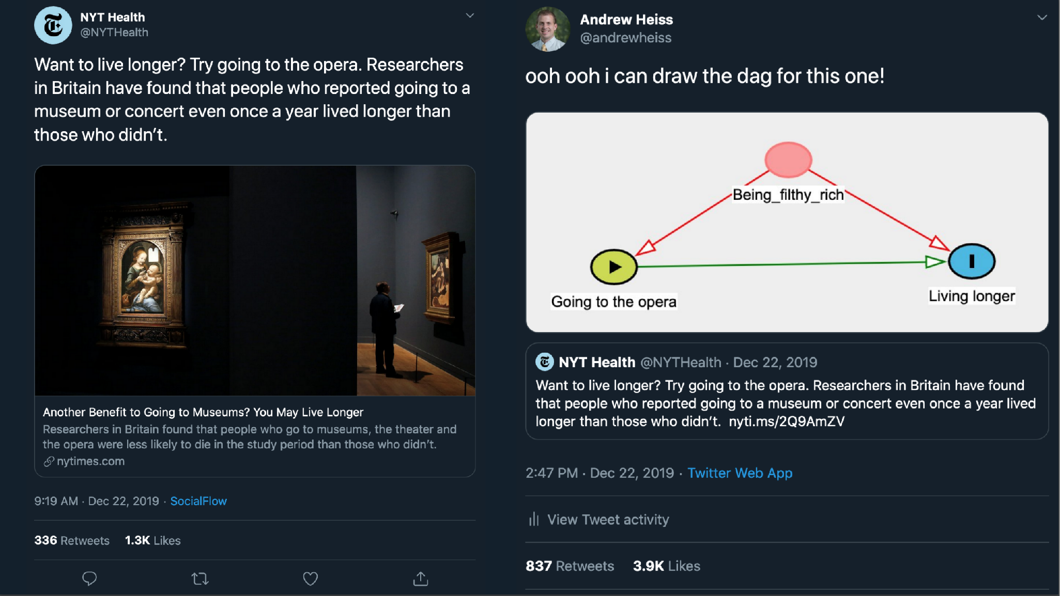

Slide 41
Notes:
Tweet from @andrewheiss “ooh ooh i can draw the dag for this one!”. Directed acyclic graph alleging that “Going to the opera” causes “Living longer”…but then adding the “hidden variable” Being_filthy_rich that causes both

Slide 42
How will we learn?

Slide 43
How will we learn?
Lectures/labs
Talk to your instructor!
Homework
Midterm exam
Final project

Slide 44
How will we learn?
Class
Tues, Wed, Thu
get familiar with R and RStudio
visualization
data manipulation
simulation
learn statistical methods
Notes:
first 5 lectures will be more hands on -- spend a lot of time in RStudio together
we'll then move to more conceptual material

Slide 45

How will we learn?
Homework
Weekly assignments
Do DataCamp exercises yourself
Otherwise you can often work in group(s)
clearly indicate who you worked with on your submission
each group member should write their own code and written responses
download and submit via Brightspace
you'll submit an RMarkdown (Rmd) file rendered as a pdf
homework that involves Rmd uploads will be available after class on (typically on Thursday), typically due 8 pm the following Wednesday
encouraged!

Slide 46
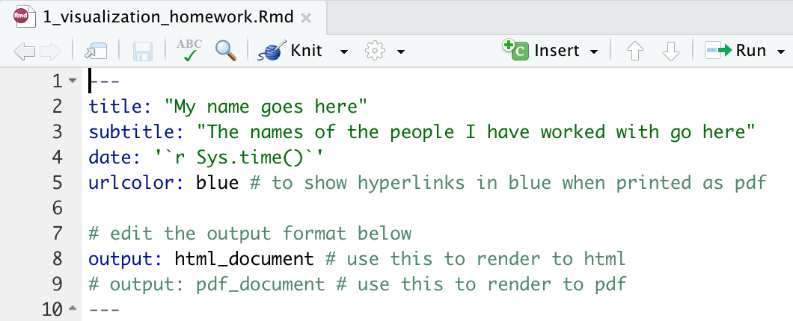
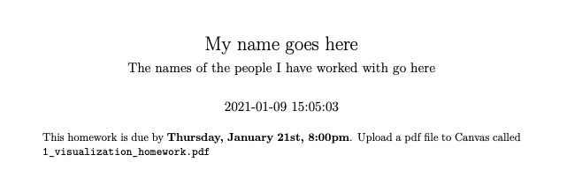
How will we learn?
Non-DataCamp Homework

Slide 47
How will we learn?
Midterm exam
like a homework assignment, but:
you have to work on it on your own
you can use any resources you like
will be submitted to Blackboard as a RMarkdown file

Slide 48
How will we learn?
Final project
Analyze some data. Consult with your instructor about it.

Slide 49
How will we learn?
Final project
structure:
short written project proposal
oral presentation
written report

Slide 50
How will we learn?
Final project
short written project proposal

Slide 51
How will we learn?
Final project
oral presentation

Slide 52
How will we learn?
Final project
written report
~ 2000 words per group member
answer an interesting research question
demonstrate what you've learned in class:
data wrangling
visualization
statistical modeling
Reporting
Upload to github

Slide 53
How will we learn?
Grading
Homework: 40%
Midterm: 20%
Final project: 40%
Proposal: 5%
Presentation: 10%
Report: 25%

Slide 54
Tools we will use in class
Blackboard
Course website
Datacamp
Github
Free online books

Slide 55
Tools we will use in class
Blackboard
We will:
send announcements
upload:
slides
class notes / code files
homework assignments
You will:
read announcements :)
upload completed homework as RMarkdown files

Slide 56
Tools we will use in class
RStudio
write code
make beautiful plots
understand statistical concepts
implement statistical models
write homework assignments using R Markdown
contribute to reproducible research

Slide 57
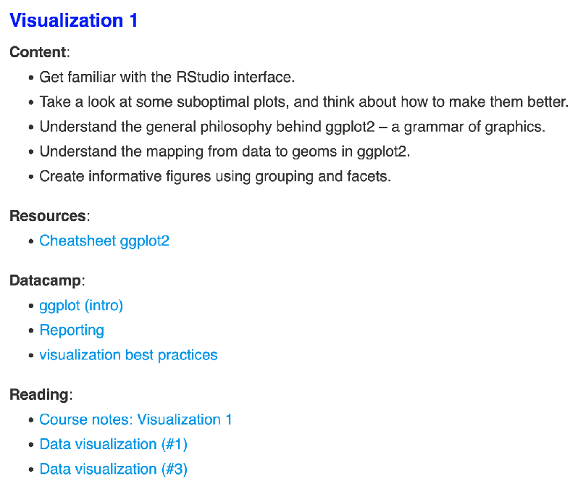


Tools we will use in class
DataCamp
use your maine.edu address to sign up!
if you haven't already, sign up here: https://tinyurl.com/psych252datacamp24

Slide 58
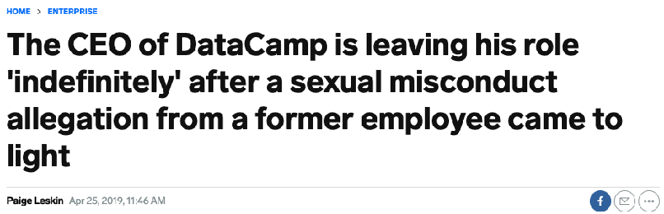
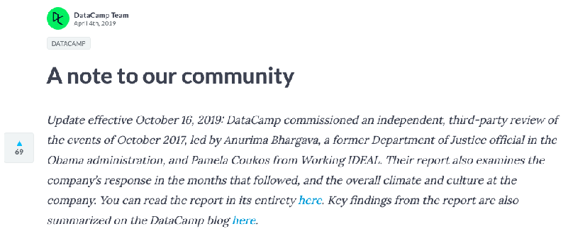
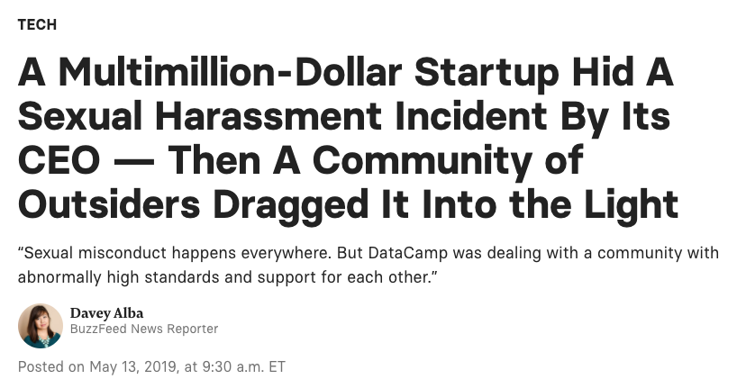

Tools we will use in class
DataCamp: mixed feelings about it
"I cannot emphasize how much I appreciated the Datacamp access; that was probably crucial to my success in this class (on top of all of the resources and materials) and I'm happy we get to keep using it in the next 3 months."
https://www.buzzfeednews.com/article/daveyalba/datacamp-sexual-harassment-metoo-tech-startup
https://www.businessinsider.com/datacamp-ceo-jonathan-cornelissen-leave-sexual-misconduct-allegation-2019-4
https://www.datacamp.com/community/blog/note-to-our-community
https://dnlmc.medium.com/dont-use-datacamp-ef04adcf1b7f

Slide 59
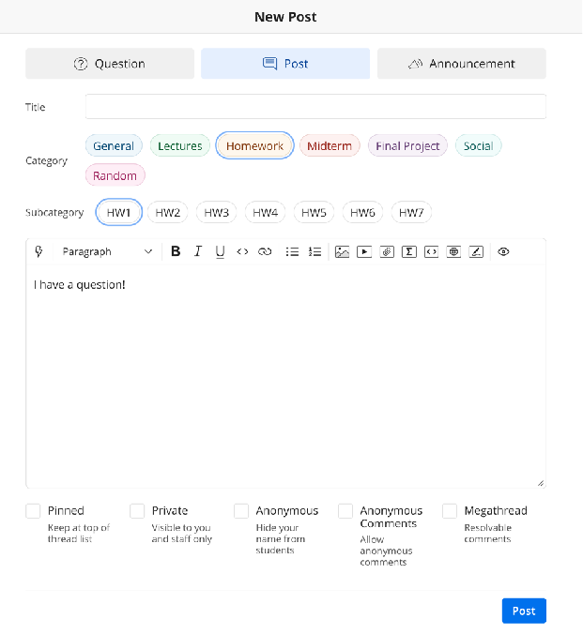



Tools we will use in class
Ed Discussion
post your own questions and answer those of your colleagues
if you want to be anonymous
if you only want to ask the teaching team

Slide 60
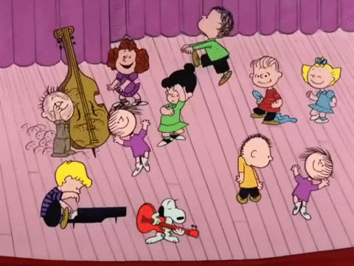

Tools we will use in class
Slack
just a space for you to build community
the teaching team won't monitor what's happening on slack
if you haven't received an invite yet, stick around at the end of class and/or send us an email

Slide 61
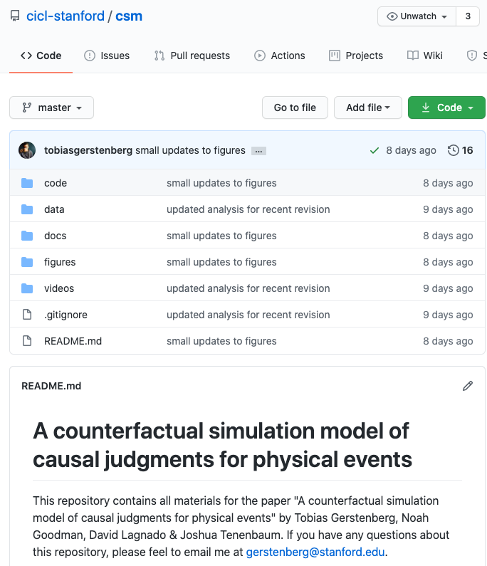

Tools we will use in class
Github
we will use github for the final project
it's an essential collaboration tool and critical for contributing to open science
you want one of these for each paper you publish!

Slide 62

Tools we will use in class
Free online books
we won't use a single text book in class
statistics and data science are developing fast and I didn't find a single book that fits the bill
but: many great, free books online
and: I will point out suggested readings as we go along
also: I'll update our course notes as we go along
feedback always welcome!

Slide 63
Fear of statistics
I don't want to make a mistake ...
What if my analysis script has bugs?
Best response: openness!
We will use github for the final projects.

Slide 64
Stats is important but ...
it's not the only thing that matters for being a good scientist
generating research ideas matters
writing matters
presenting matters
...
(nobody is very good at all of these things)

Slide 65
Feedback

Slide 66

Thanks!
make sure to have
R and RStudio up to date

